Slide 1
SAMPLING THEORY AND STUDY DESIGN
DATA COLLECTION AND DATA PROCESSING
“The latest survey shows that 3 out of 4 people make up 75% of the population”
D. Letterman

Slide 2
The Goal of Good Study/Sampling Design
We need data that can:
provide legitimate insight into our system of interest;
provide correct, accurate answers to relevant questions;
support the drawing of legitimate, valid conclusions, with the ability to qualify these conclusions in terms of scope and precision.
This starts with study design – what data to collect and how it should be collected

Slide 3
[G. Smith, The Exaggerated Promise of So-Called Unbiased Data Mining]
“A Dartmouth graduate student used an MRI machine to study the brain activity of a salmon as it was shown photographs and asked questions. The most interesting thing about the study was not that a salmon was studied, but that the salmon was dead. Yep, a dead salmon purchased at a local market was put into the MRI machine, and some patterns were discovered. There were inevitably patterns—and they were invariably meaningless.”

Slide 4
NPS AND PATTERN Fishing
Two separate issues can be combined to cause problems with data analysis:
drawing conclusions (inferences) from a sample about a population that are not warranted by the sample collection method (symptomatic of NPS);
looking for any available patterns in the data and then coming up with post hoc explanations for these patterns.
Alone or in combination, these lead to poor (and potentially harmful) conclusions.

Slide 5
STUDIES AND SURVEYS
A survey is any activity that collects information about characteristics of interest:
in an organized and methodical manner;
from some or all units of a population;
using well-defined concepts, methods, and procedures, and
compiles such information into a meaningful summary form.

Slide 6
SAMPLING MODELS
A census is a survey where information is collected from all units of a population, whereas a sample survey uses only a fraction of the units.
When survey sampling is done properly, we may be able to use various statistical methods to make inferences about the target population by sampling a (comparatively) small number of units in the study population.

Slide 8
SURVEY FRAMES
The ideal frame contains identification data, contact data, classification data, maintenance data, and linkage data, and must minimize the risk of undercoverage or overcoverage, as well as the number of duplications and misclassifications (although some issues that arise can be fixed at the data processing stage).
A statistical sampling approach is contraindicated unless the selected frame is
relevant (which is to say, it corresponds, and permits accessibility to, the target population),
accurate (the information it contains is valid),
timely (it is up-to-date), and
competitively priced.

Slide 9
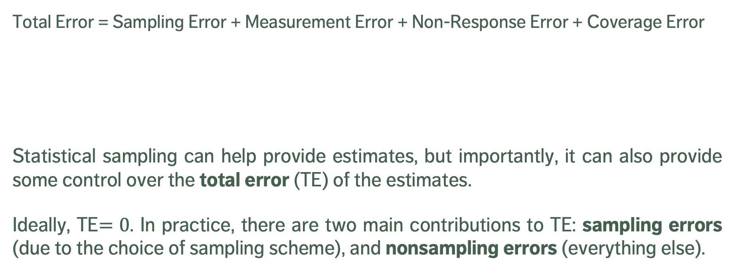
SURVEY ERROR
Total Error = Sampling Error + Measurement Error + Non-Response Error + Coverage Error
Statistical sampling can help provide estimates, but importantly, it can also provide some control over the total error (TE) of the estimates.
Ideally, TE$=0$. In practice, there are two main contributions to TE: sampling errors (due to the choice of sampling scheme), and nonsampling errors (everything else).
survey, not census
observations not measured accurately
non-respondents having systematic observation differences
frame decay and/or corruption

Slide 10
NONSAMPLING ERROR
Nonsampling error can be controlled, to some extent:
coverage error can be minimized by selecting high quality, up-to-date survey frames;
non-response error can be minimized by careful choice of the data collection mode and questionnaire design, and by using “call-backs” and “follow-ups”;
measurement error can be minimized by careful questionnaire design, pre-testing of the measurement apparatus, and cross-validation of answers.
In practice, these suggestions are not that useful in modern times (landline-based survey frames are becoming irrelevant due to demographics, response rates for surveys that are not mandated by law are low, etc.). This explains, in part, the over-use of web scraping and non-probabilistic sampling.

Slide 11
NONPROBABILISTIC SAMPLING
Nonprobabilistic sampling (NPS) methods (designs) select sampling units from the target population using subjective, non-random approaches.
NPS are quick, relatively inexpensive and convenient (no survey frame required).
NPS methods are ideal for exploratory analysis and survey development.
Unfortunately, NPS are often used instead of probabilistic designs (problematic)
the associated selection bias makes NPS methods unsound when it comes to inferences (they cannot be used to provide reliable estimates of the sampling error, the only component of TE under the analyst’s direct control);
automated data collection often fall squarely in the NPS camp – we can still analyze data collected with a NPS approach, but may not generalize the results to the target population.

Slide 12
PROBABILISTIC SAMPLING
Probabilistic sample designs are usually more difficult and expensive to set-up (due to the need for a quality survey frame), and take longer to complete.
They provide reliable estimates for the attribute of interest and the sampling error, paving the way for small samples being used to draw inferences about larger target populations (in theory, at least; the non-sampling error components can still affect results and generalisation).

Slide 13
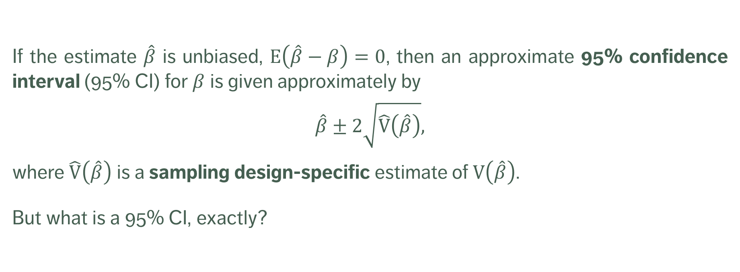
CONFIDENCE INTERVALS
If the estimate $\hat{β}$ is unbiased, $E\left(\hat{β}−β\right)=0$, then an approximate 95% confidence interval (95% CI) for $β$ is given approximately by
$$\hat{β}±2\sqrt{\hat{\text{V}}\left(\hat{β}\right)},$$
where $\hat{\text{V}}\left(\hat{β}\right)$ is a sampling design-specific estimate of $\text{V}\left(\hat{β}\right)$.
But what is a 95% CI, exactly?

Slide 14
SAMPLING DESIGN
Different sampling designs have distinct advantages and disadvantages.
They can be used to compute estimates
for various population attributes: mean, total, proportion, ratio, difference, etc.
for the corresponding 95% CI.
We might also want to compute sample sizes for a given error bound (an upper limit on the radius of the desired 95% CI), and how to determine the sample allocation (how many units to be sampled in various sub-population groups).

Slide 15
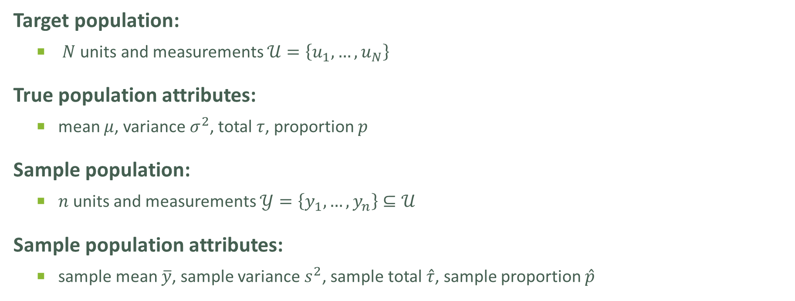
SAMPLING DESIGN – UNIVERSE OF DISCOURSE
Target population:
$N$units and measurements $𝒰=\left\{u_{1},…,u_{N}\right\}$
True population attributes:
mean $μ$, variance $σ^{2}$, total $τ$, proportion $p$
Sample population:
$n$units and measurements $𝒴=\left\{y_{1},…,y_{n}\right\}⊆𝒰$
Sample population attributes:
sample mean $\overline{y}$, sample variance $s^{2}$, sample total $\hat{τ}$, sample proportion $\hat{p}$

Slide 16

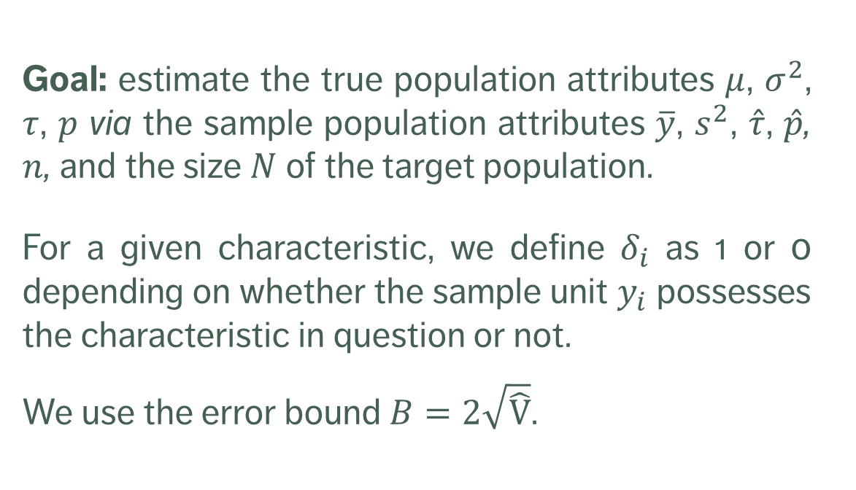
SAMPLING DESIGN – UNIVERSE OF DISCOURSE
Goal: estimate the true population attributes $μ$, $σ^{2}$, $τ$, $p$ via the sample population attributes $\overline{y}$, $s^{2}$, $\hat{τ}$, $\hat{p}$, $n$, and the size $N$ of the target population.
For a given characteristic, we define $δ_{i}$ as 1 or 0 depending on whether the sample unit $y_{i}$ possesses the characteristic in question or not.
We use the error bound $B=2\sqrt{\hat{\text{V}}}$.

Slide 17
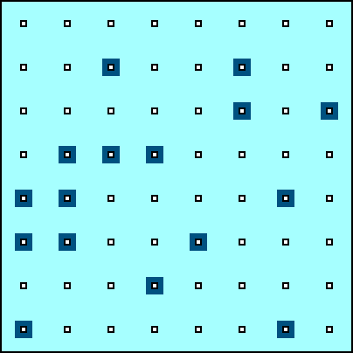
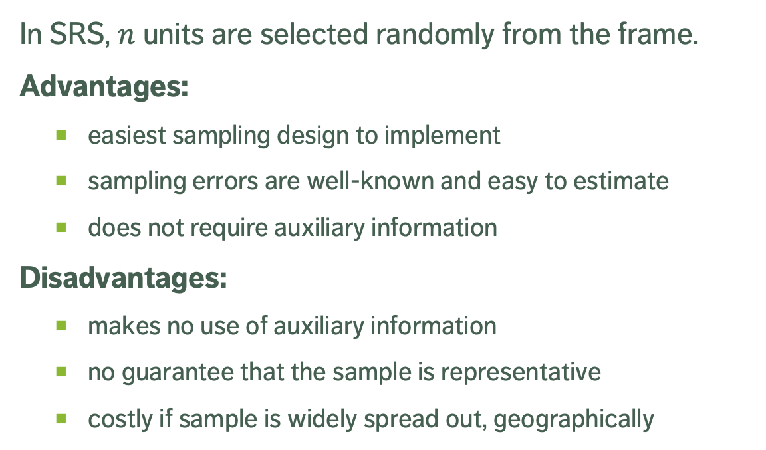
SIMPLE RANDOM SAMPLING (SRS)
In SRS, $n$ units are selected randomly from the frame.
Advantages:
easiest sampling design to implement
sampling errors are well-known and easy to estimate
does not require auxiliary information
Disadvantages:
makes no use of auxiliary information
no guarantee that the sample is representative
costly if sample is widely spread out, geographically

Slide 18
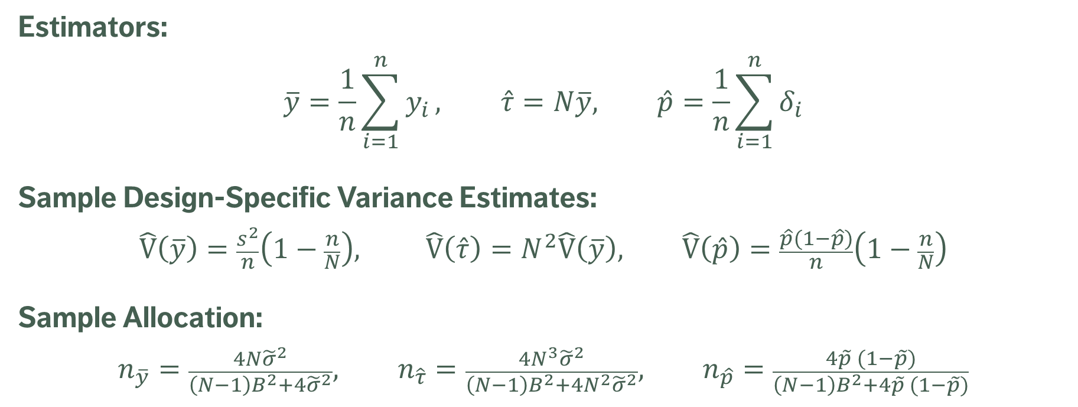
SRS ESTIMATORS
Estimators:
$$\overline{y}=\frac{1}{n}\sum_{i=1}^{n}{y_{i}}, \hat{τ}=N\overline{y}, \hat{p}=\frac{1}{n}\sum_{i=1}^{n}{δ_{i}}$$
Sample Design-Specific Variance Estimates:
$$\hat{\text{V}}\left(\overline{y}\right)=\frac{s^{2}}{n}\left(1−\frac{n}{N}\right), \hat{\text{V}}\left(\hat{τ}\right)=N^{2}\hat{\text{V}}\left(\overline{y}\right), \hat{\text{V}}\left(\hat{p}\right)=\frac{\hat{p}(1−\hat{p})}{n}\left(1−\frac{n}{N}\right)$$
Sample Allocation:
$$n_{\overline{y}}=\frac{4N{\tilde{σ}}^{2}}{\left(N−1\right)B^{2}+4{\tilde{σ}}^{2}}, n_{\hat{τ}}=\frac{4N^{3}{\tilde{σ}}^{2}}{\left(N−1\right)B^{2}+4N^{2}{\tilde{σ}}^{2}}, n_{\hat{p}}=\frac{4\tilde{p} (1−\tilde{p})}{\left(N−1\right)B^{2}+4\tilde{p} (1−\tilde{p})}$$

Slide 19
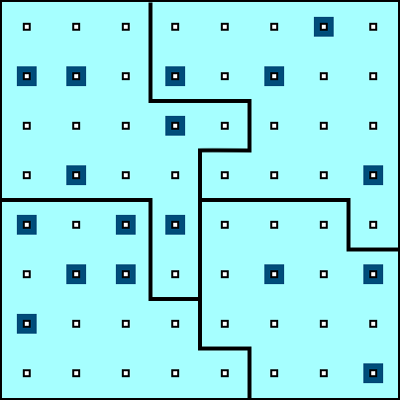
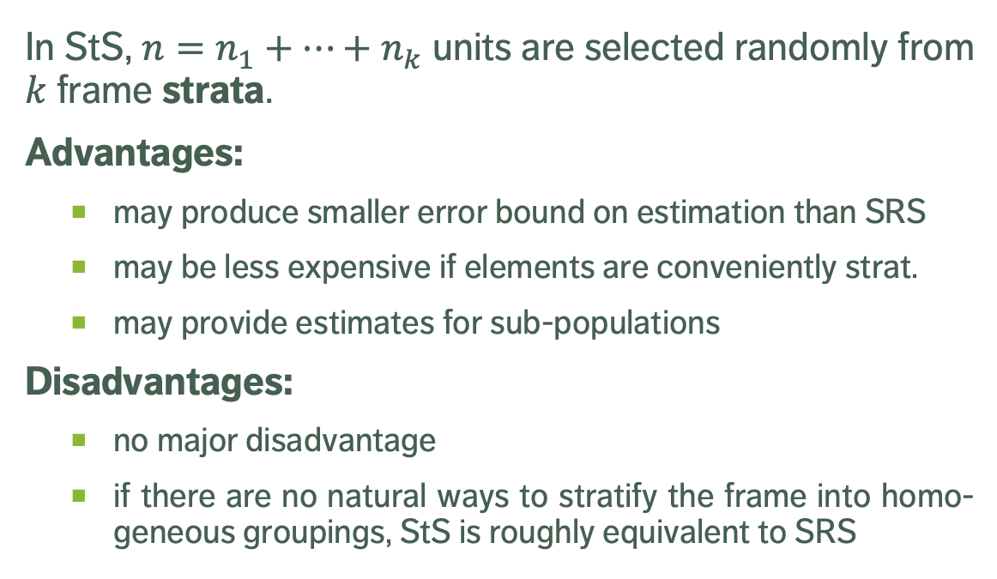
STRATIFIED RANDOM SAMPLING (StS)
In StS, $n=n_{1}+⋯+n_{k}$ units are selected randomly from $k$ frame strata.
Advantages:
may produce smaller error bound on estimation than SRS
may be less expensive if elements are conveniently strat.
may provide estimates for sub-populations
Disadvantages:
no major disadvantage
if there are no natural ways to stratify the frame into homo-geneous groupings, StS is roughly equivalent to SRS

Slide 20
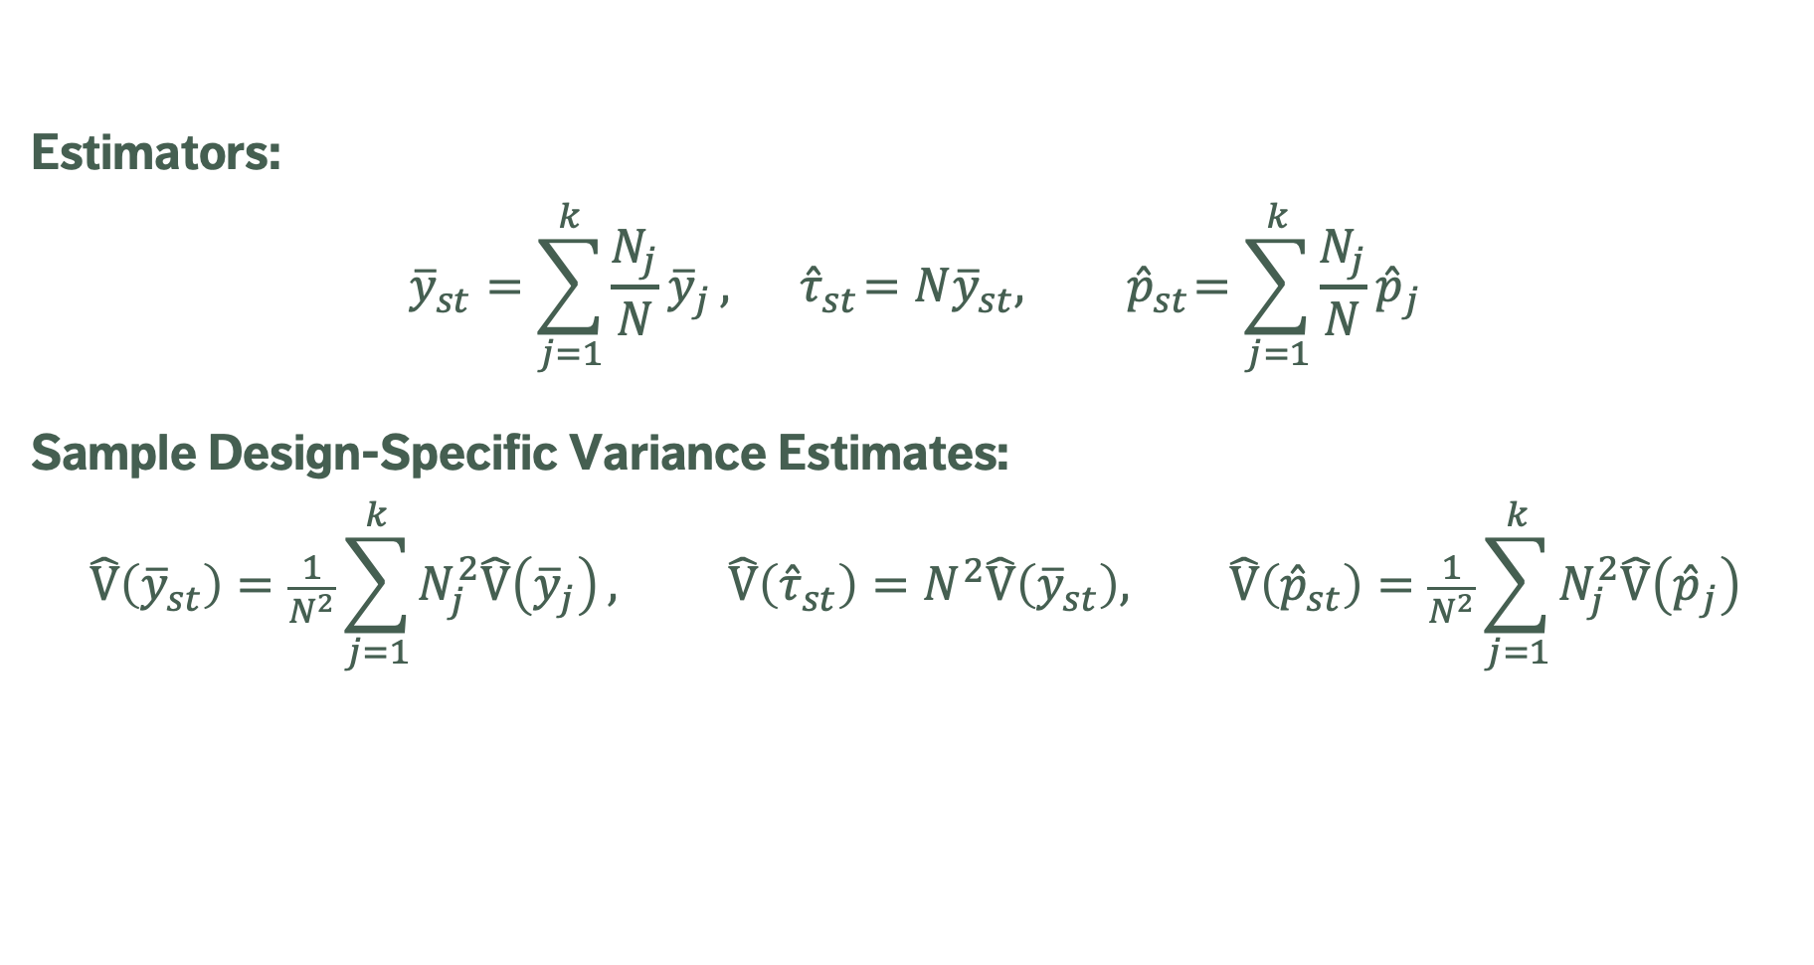
STS ESTIMATORS
Estimators:
$${\overline{y}}_{st}=\sum_{j=1}^{k}{\frac{N_{j}}{N}{\overline{y}}_{j}}, { \hat{τ}}_{st}=N{\overline{y}}_{st},{ \hat{p}}_{st}=\sum_{j=1}^{k}{\frac{N_{j}}{N}{\hat{p}}_{j}}$$
Sample Design-Specific Variance Estimates:
$$\hat{\text{V}}\left({\overline{y}}_{st}\right)=\frac{1}{N^{2}}\sum_{j=1}^{k}{N_{j}^{2}\hat{\text{V}}\left({\overline{y}}_{j}\right)}, \hat{\text{V}}\left({\hat{τ}}_{st}\right)=N^{2}\hat{\text{V}}\left({\overline{y}}_{st}\right), \hat{\text{V}}\left({\hat{p}}_{st}\right)=\frac{1}{N^{2}}\sum_{j=1}^{k}{N_{j}^{2}\hat{\text{V}}\left({\hat{p}}_{j}\right)}$$

Slide 21
EXERCISES
You are charged with estimating the yearly salary of data scientists in Canada.
Identify potential:
populations (target, study, respondent, sampling frames)
samples (intended, achieved)
unit information (unit, response variate, population attribute)
sources of bias (coverage, nonresponse, sampling, measurement) and variability (sampling, measurement).

Slide 22
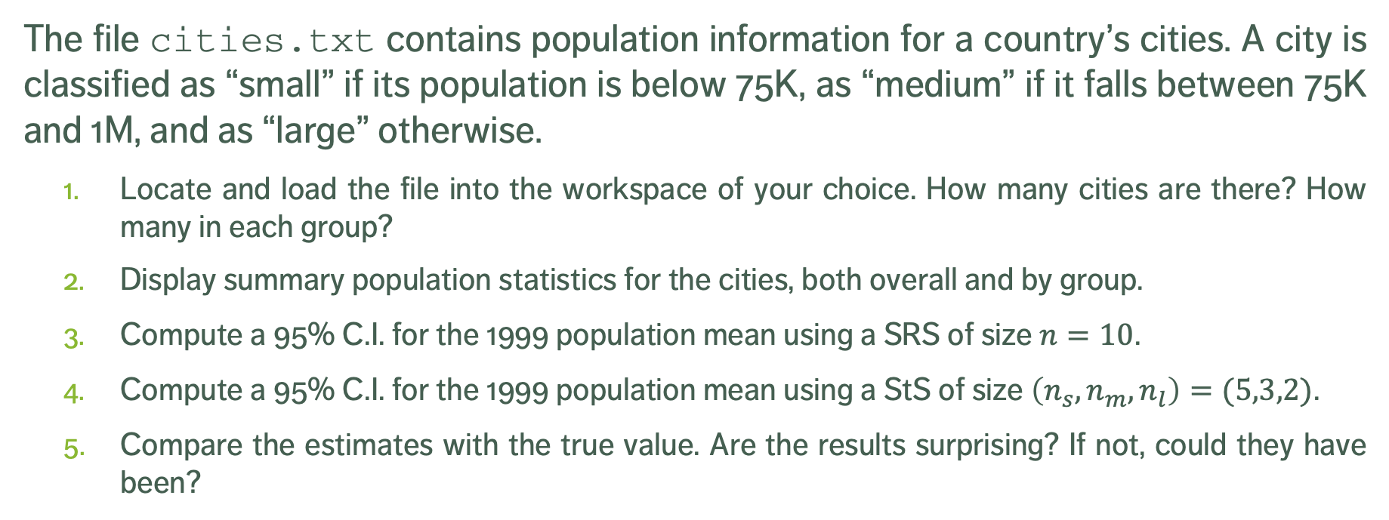
EXERCISES
The file cities.txt contains population information for a country’s cities. A city is classified as “small” if its population is below 75K, as “medium” if it falls between 75K and 1M, and as “large” otherwise.
Locate and load the file into the workspace of your choice. How many cities are there? How many in each group?
Display summary population statistics for the cities, both overall and by group.
Compute a 95% C.I. for the 1999 population mean using a SRS of size $n=10$.
Compute a 95% C.I. for the 1999 population mean using a StS of size $\left(n_{s},n_{m},n_{l}\right)=(5,3,2)$.
Compare the estimates with the true value. Are the results surprising? If not, could they have been?

Slide 23
Supplemental Material

Slide 24
DECIDING FACTORS
In some instances, information about the entire population is required in order to answer questions, whereas in others it is not necessary. The survey type depends on multiple factors:
the type of question that needs to be answered;
the required precision;
the cost of surveying a unit;
the time required to survey a unit;
size of the population under investigation, and
the prevalence of the attributes of interest.

Slide 25
STUDY/SURVEY STEPS
data processing and imputation
estimation
data analysis
dissemination
documentation
Studies or surveys follow the same general steps:
statement of objective
selection of survey frame
sampling design
questionnaire design
data collection
data capture and coding
The process is not always linear, but there is a definite movement from objective to dissemination.

Slide 26
SURVEY FRAMES
The frame provides the means of identifying and contacting the units of the study population. It is generally costly to create and to maintain (in fact, there are organisations and companies that specialise in building and/or selling such frames).
Useful frames contain:
identification data,
contact data,
classification data,
maintenance data, and
linkage data.

Slide 27
MODES OF DATA COLLECTION
Paper-based vs. computer-assisted
self-administered questionnaires are used when the survey requires detailed information to allow the units to consult personal records; associated with high non-response rate.
interviewer-assisted questionnaires use well-trained interviewers to increase the response rate and overall quality of the data; face-to-face vs. telephone.
computer-assisted interviews combine data collection and data capture, which saves time.
unobtrusive direct observation
diaries to be filled (paper or electronic)
omnibus surveys
email, Internet, and social media

Slide 28
NPS METHODS
Haphazard
man on the street, depends on availability of units and interviewer bias
Volunteer
self-selection bias
Judgement
biased by inaccurate preconceptions about the target population
Quota
exit polling, ignores non-response bias

Slide 29
NPS METHODS
Modified
starts probabilistic, switches to quota as a reaction to high non-response rates
Snowball
“pyramid” scheme
There are contexts where NPS methods might fit a client’s or an organization’s need (and that remains their decision to make, ultimately), but they must be informed of the drawbacks, and presented with some probabilistic alternatives.

Slide 30
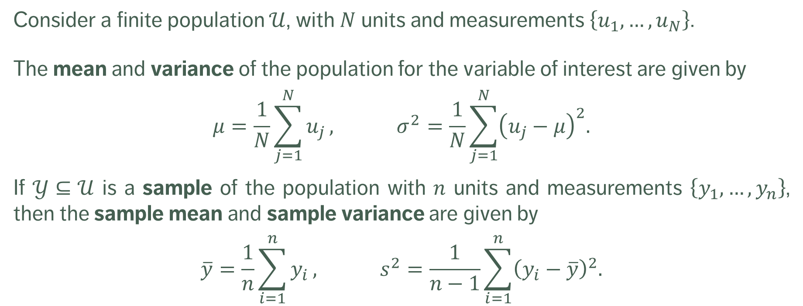
BASIC MATHEMATICAL CONCEPTS
Consider a finite population $𝒰$, with $N$units and measurements $\left\{u_{1},…,u_{N}\right\}$.
The mean and variance of the population for the variable of interest are given by
$$μ=\frac{1}{N}\sum_{j=1}^{N}{u_{j}}, σ^{2}=\frac{1}{N}\sum_{j=1}^{N}{{\left(u_{j}−μ\right)}^{2}.}$$
If $𝒴⊆𝒰$ is a sample of the population with $n$ units and measurements $\left\{y_{1},…,y_{n}\right\}$, then the sample mean and sample variance are given by
$$\overline{y}=\frac{1}{n}\sum_{i=1}^{n}{y_{i}}, s^{2}=\frac{1}{n−1}\sum_{i=1}^{n}{{\left(y_{i}−\overline{y}\right)}^{2}.}$$

Slide 31
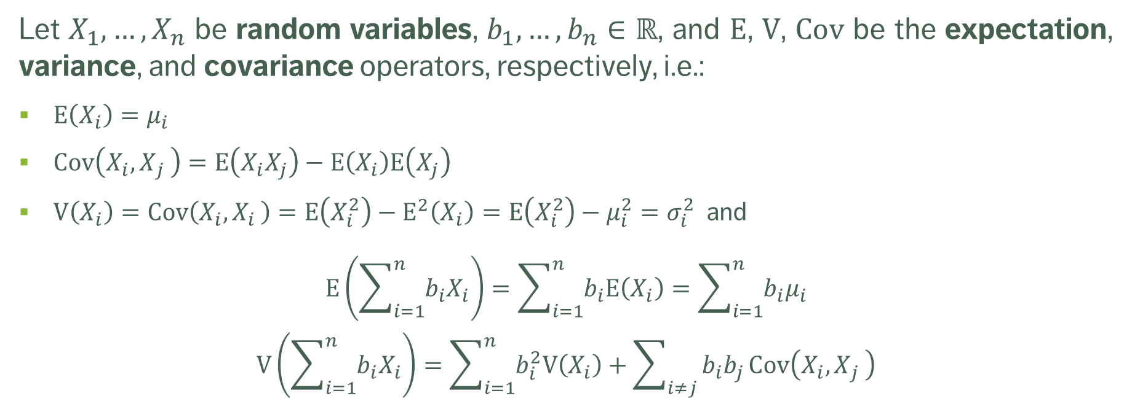
BASIC MATHEMATICAL CONCEPTS
Let $X_{1},…,X_{n}$ be random variables, $b_{1},…,b_{n}∈ℝ$, and $\text{E}$, $\text{V}$, $\text{Cov}$ be the expectation, variance, and covariance operators, respectively, i.e.:
$\text{E}\left(X_{i}\right)=μ_{i}$
$\text{Cov}\left(X_{i}{,X}_{j}\right)=\text{E}\left(X_{i}X_{j}\right)−\text{E}\left(X_{i}\right)\text{E}\left(X_{j}\right)$
$\text{V}\left(X_{i}\right)=\text{Cov}\left(X_{i}{,X}_{i}\right)=\text{E}\left(X_{i}^{2}\right)−{\text{E}}^{2}\left(X_{i}\right)=\text{E}\left(X_{i}^{2}\right)−μ_{i}^{2}=σ_{i}^{2}$ and
$$\text{E}\left(\sum_{i=1}^{n}{b_{i}X_{i}}\right)=\sum_{i=1}^{n}{b_{i}\text{E}\left(X_{i}\right)}=\sum_{i=1}^{n}{b_{i}μ_{i}}$$
$$\text{V}\left(\sum_{i=1}^{n}{b_{i}X_{i}}\right)=\sum_{i=1}^{n}{b_{i}^{2}\text{V}\left(X_{i}\right)}+\sum_{i≠j}{b_{i}b_{j}}\text{Cov}\left(X_{i}{,X}_{j}\right)$$

Slide 32
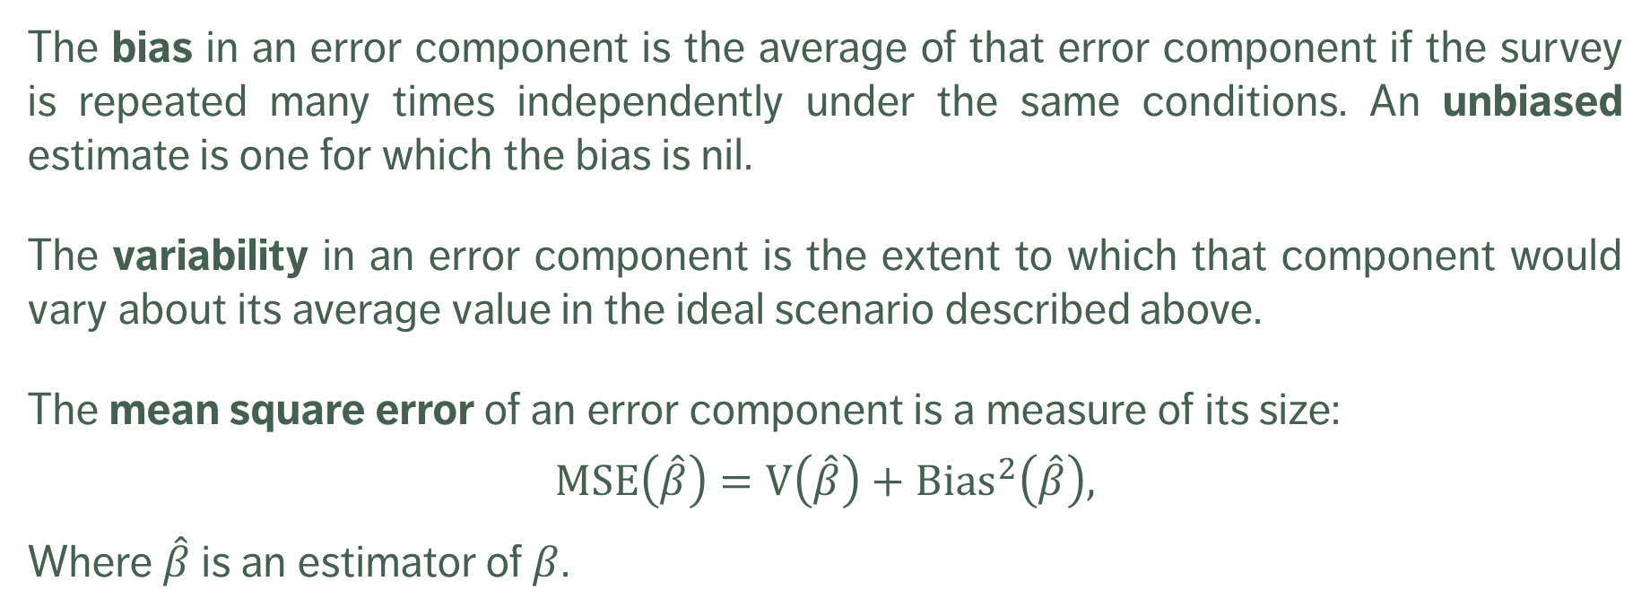
BASIC MATHEMATICAL CONCEPTS
The bias in an error component is the average of that error component if the survey is repeated many times independently under the same conditions. An unbiased estimate is one for which the bias is nil.
The variability in an error component is the extent to which that component would vary about its average value in the ideal scenario described above.
The mean square error of an error component is a measure of its size:
$$MSE\left(\hat{β}\right)=\text{V}\left(\hat{β}\right)+{\text{Bias}}^{2}\left(\hat{β}\right),$$
Where $\hat{β}$ is an estimator of $β$.

Slide 33
PROBABILISTIC SAMPLING DESIGNS
Probability proportional-to-size sampling (PPS)
Replicated sampling (ReS)
Multi-stage sampling (MSS)
Multi-phase sampling (MPS)
Simple random sampling (SRS)
Stratified random sampling (StS)
Systematic sampling (SyS)
Cluster sampling (ClS)

Slide 34
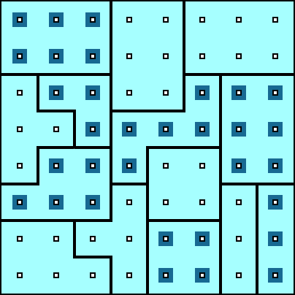
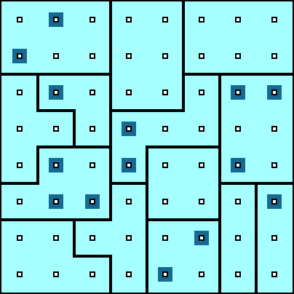
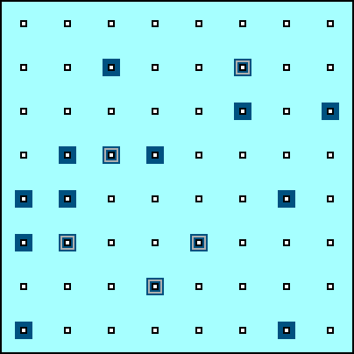
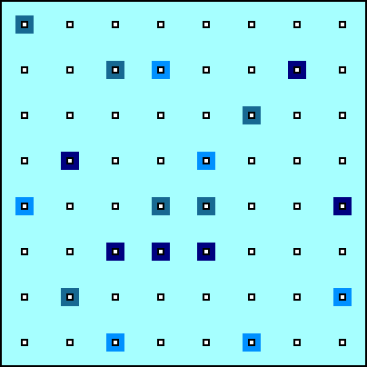
OTHER EXAMPLES OF SAMPLING DESIGNS
Cluster Sampling (ClS)
Multi-Stage Sampling (MSS)
Multi-Phase Sampling (MPS)
Replicated Sampling (ReS)

